Slide 1

CHAPTER 9
QUALITY MANAGEMENT
QUALITY CONTROL & MANAGEMENT- AHSAN AKHTAR HASIN (2ND ED.)
CHAPTER: 1,3,4,6,16

Slide 2

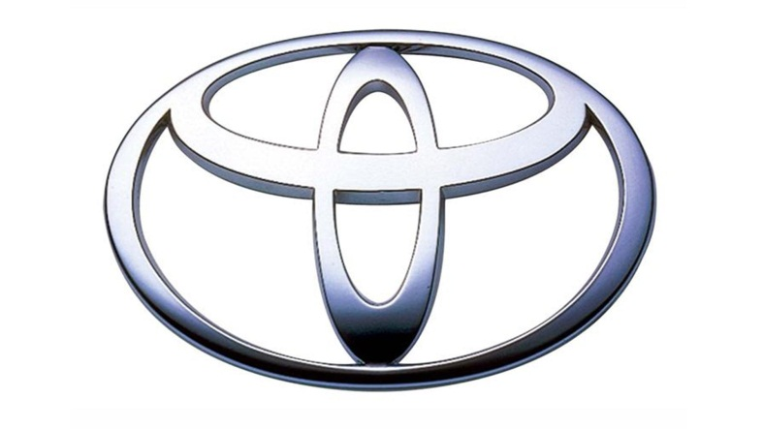
WHAT IS QUALITY?
Quality refers to the characteristics of a product or service that defines its ability to consistently meet or exceed customers expectation
Quality revolution started in Japan after World War ii
Increased quality means decreased cost
Honda and Toyota accounts for 20% of the automotive sales in USA

Slide 3
COMMONLY CONSIDERED QUALITY ASPECTS
Performance-appropriate functionality
Conformance-products response to specifications
Reliability-probability of performance
Durability-longevity
Innovative feature-more than normal need
Service after sale-customer care
Maintenance and serviceability-self maintenance
Ease of use-
Aesthetics
Others.

Slide 4
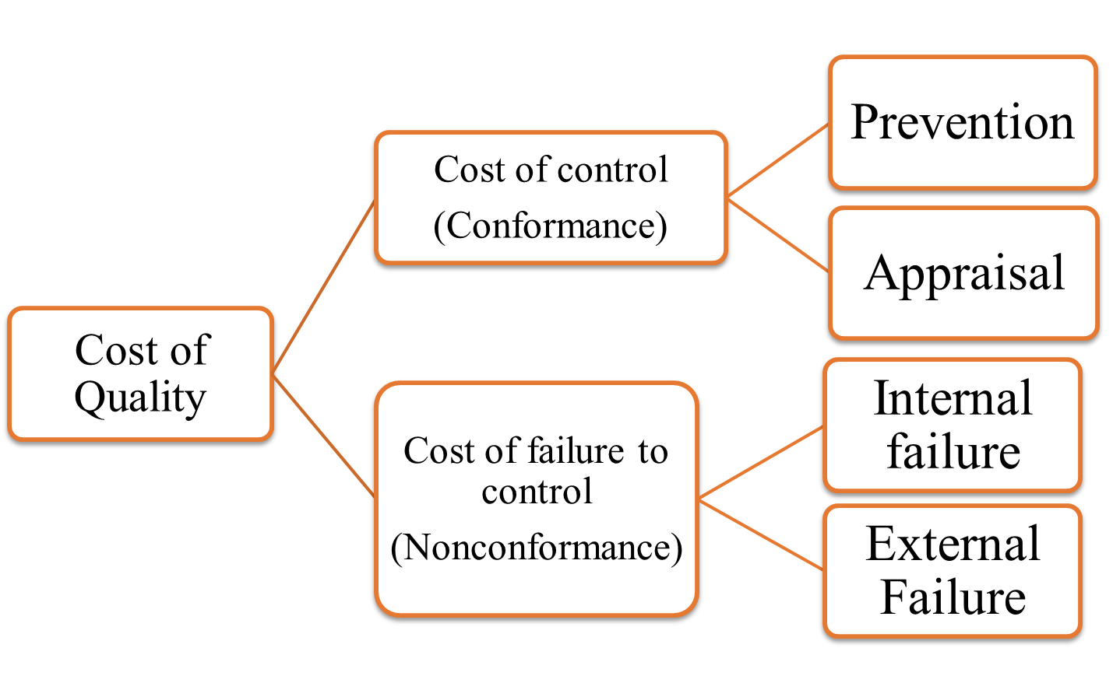
COST OF QUALITY

Slide 5
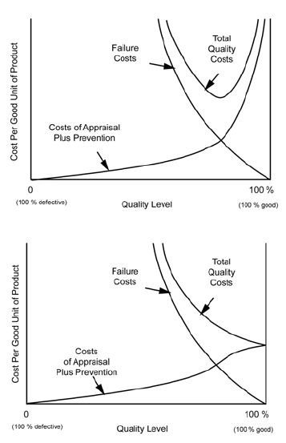
OPTIMUM QUALITY
COST
1st Image: Juran Model of Quality Costs (zone of perfection, zone of indifference, zone of improvement projects).
2nd Image: Alternative view (prevention and appraisal cost curve flattens out after a certain degree of perfection is achieved)

Slide 6
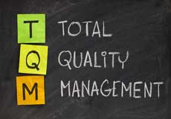
EVOLUTION OF MODERN CONCEPTS
Early stage: Inspection based Quality (corrective action took place at the end of the production line, when wastes are already created)
The next stage: Statistical Quality Control (Sample based inspection system instead of heavy inspection- random samples are taken to test the level of quality of a process)
The third stage: Quality Assurance
Last and current stage:
Total Quality Management(TQM)

Slide 7
DIFFERENCE BETWEEN QUALITY ASSURANCE & QUALITY CONTROL
Criteria | Quality Assurance (QA) | Quality Control (QC)
Definition | QA is a set of activities for ensuring quality in the processes by which products are developed. | QC is a set of activities for ensuring quality in products. The activities focus on identifying defects in the actual products produced.
Type of action | Proactive | Reactive
Responsibility | Everyone on the team involved in developing the product is responsible for quality assurance. | Quality control is usually the responsibility of a specific team that tests the product for defects.
As a tool | QA is a managerial tool | QC is a corrective tool

Slide 8
TOTAL QUALITY MANAGEMENT (TQM)
TQM refers to “Organization wide effort to achieve quality”.
TQM is a philosophy about quality that suggests for involving everyone in the organization is a quest for Quality
Maintaining Quality is not only the duty of a particular department, it is the duty of each and every department and person in the organization

Slide 9

SEVEN BASIC TOOLS OF TQM
As much as 95% of quality related problems can be solved with fundamental quantitative tools listed below:
        Check sheet
        Stratification analysis
        Histogram
        Pareto analysis
        Process flow chart
        Cause-Effect diagram
        Scatter diagram
        Control chart

Slide 10
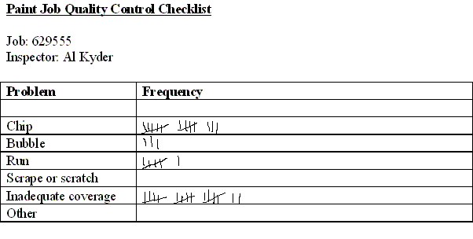

Slide 11
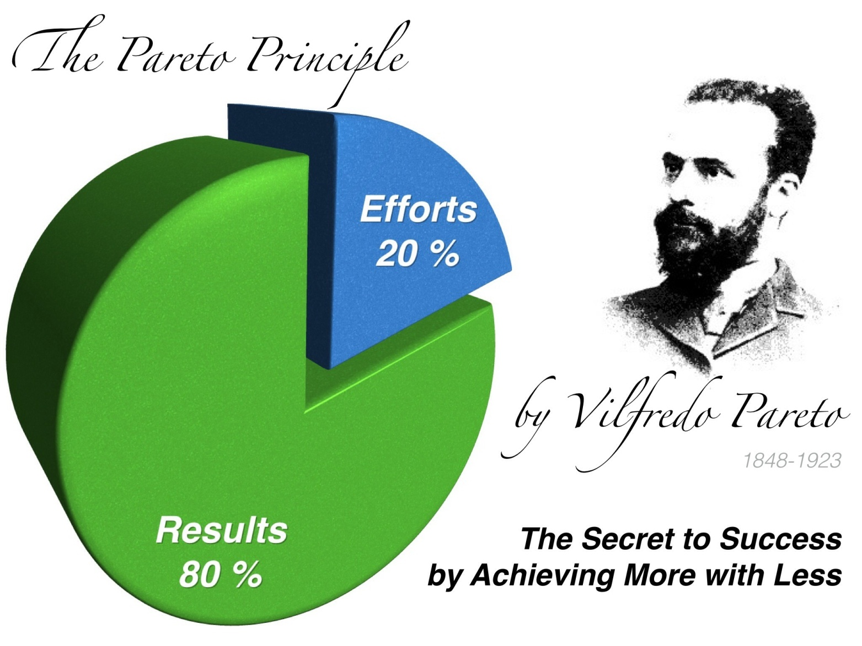
PARETO ANALYSIS (80-20 RULE)

Slide 12


Slide 13
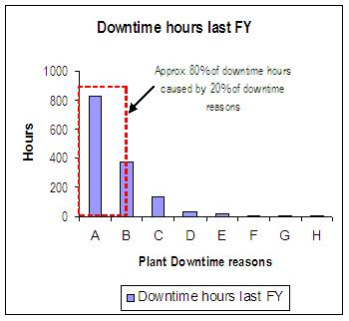
PARETO ANALYSIS
VITAL FEW
TRIVIAL MANY

Slide 14
PLOTTING A PARETO CHART
Defect Type | Frequency | % of Frequncy | Cumulative %
Wrong dimension | 55 | 35% | 35%
wrong materian | 41 | 26% | 60%
scratch | 30 | 19% | 79%
shrinkage | 15 | 9% | 89%
wear | 10 | 6% | 95%
others | 8 | 5% | 100%
Decorate the Frequency data from larger to smaller value.

Slide 15
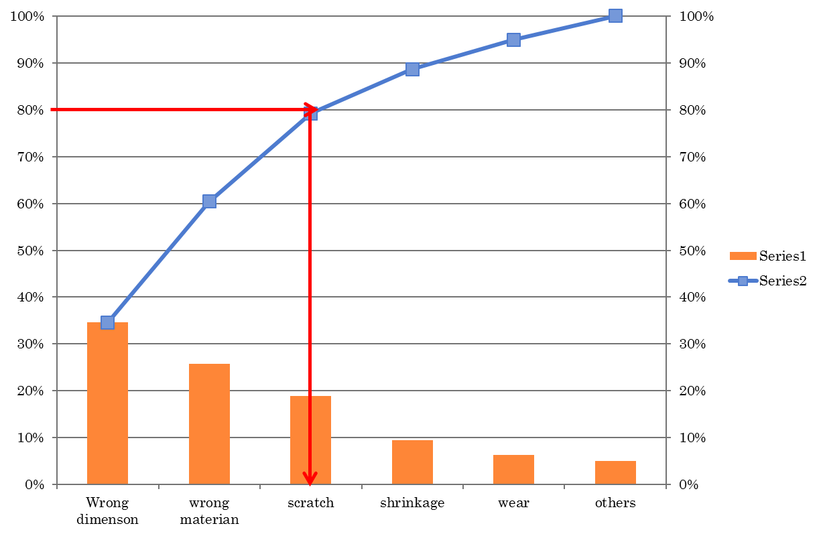

Slide 16
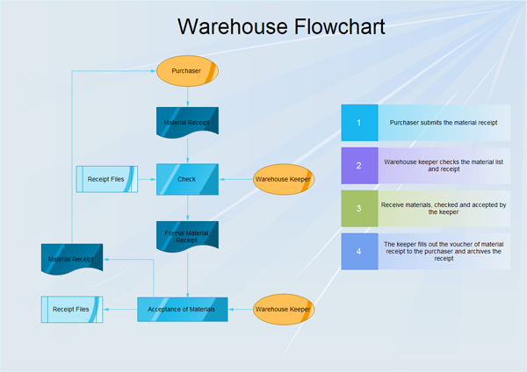
PROCESS FLOW CHART

Slide 17
CAUSE EFFECT DIAGRAM
In BSRM Steel Mill they face a problem Called “Roof Leakage”. So they identified some causes that may be the reasons behind the problem. Those are, (7)
• 3 persons needed to operate the process. But 2 persons were available.
• There Were a lot of dust in Raw Material
• Electricity was off due to thunderstorm
• Highest Temperature of molten metal should have been 1670 degree Celsius, but it was 1750.
• Machine hose pipe was loose.
• The operators had only 3 months experience in the steel sector.
• The raw material need hard pressing after discharging, but it was not done properly.

Slide 18
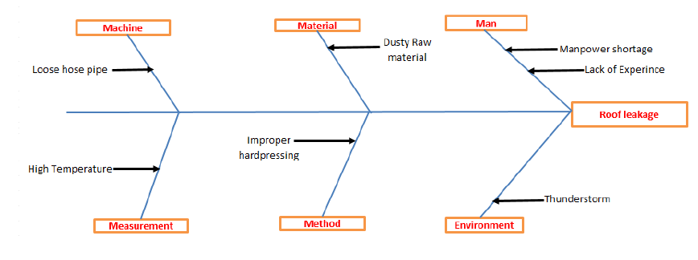

Slide 19
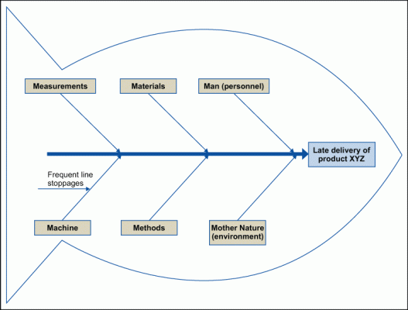
CAUSE-EFFECT DIAGRAM (OR FISH BONE DIAGRAM)

Slide 20
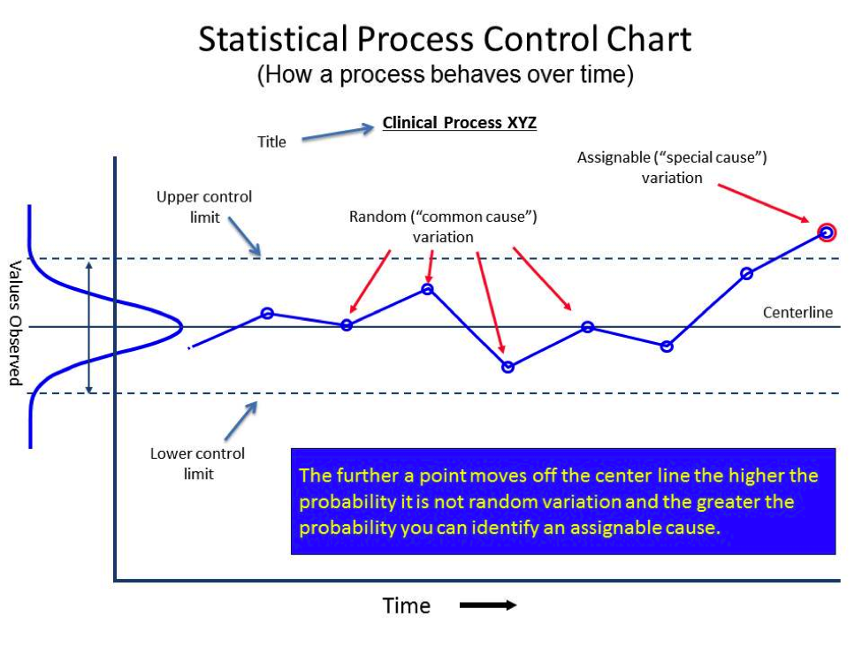
CONTROL CHART
Chance or Common Cause: Variation because of this type of causes are very natural and very difficult to control fully.
Assignable or Special Cause: Variation from this type of causes are identifiable, and maybe significant for product/service quality.

Slide 21
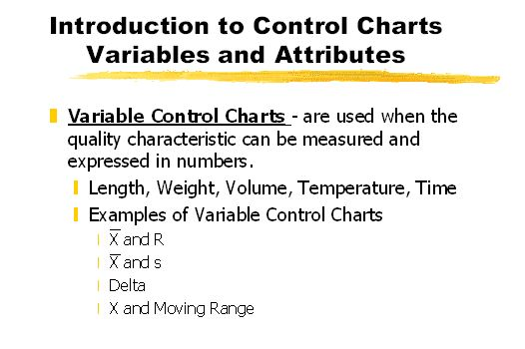
CONTROL CHART

Slide 22
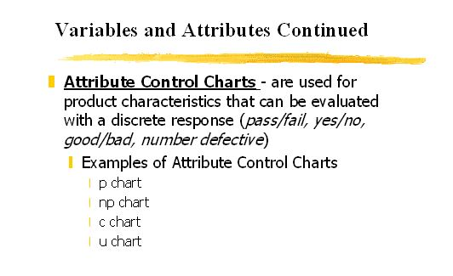
CONTROL CHART

Slide 23
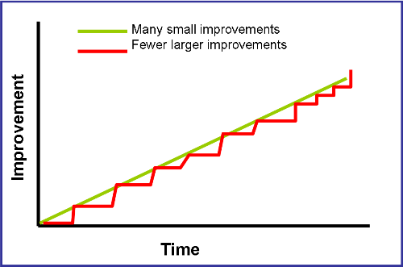
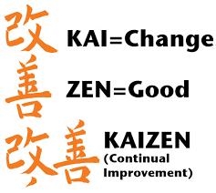
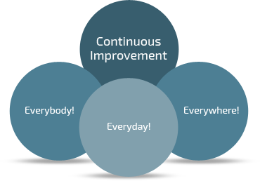
OTHER PHILOSOPHIES OF TQM: KAIZEN
KAIZEN

Slide 24
OTHER PHILOSOPHIES OF TQM:BPR
BPR is the critical analysis and radical redesign of existing business processes to achieve breakthrough improvements in performance measures.
This is a radical, one-time, structural change
Top-down approach
Bears High Risk
Example: 5 Slitting process in AKS Steel
Improvement
Time
Business Process Reengineering (BPR)

Slide 25

TOTAL PRODUCTIVE MAINTENANCE (TPM)

Slide 26
TOTAL PRODUCTIVE MAINTENANCE (TPM)
Traditional mindset of the operators is like whenever there is a mechanical trouble, they stop working and would call the mechanics to fix the problem. On the other hand, the mechanics loved the smell of a breakdown! It gave them a feeling that they are indispensable part of the company.
This resulted in loss of labor hour, production time and opportunity cost.
The goal of TPM is a production environment free from breakdowns & technical disturbances by involving everyone in maintenance duties without heavily relying on mechanics or engineers.

Slide 27
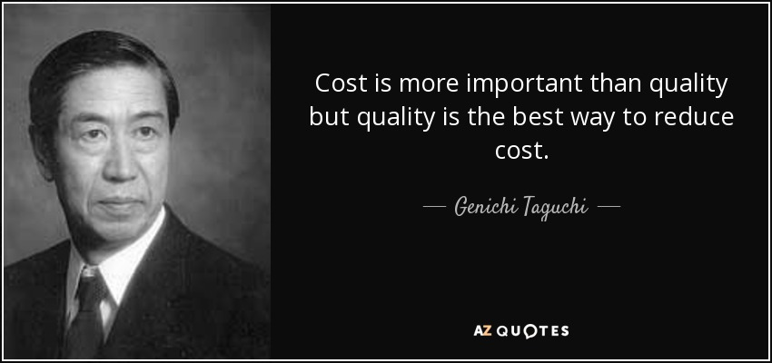
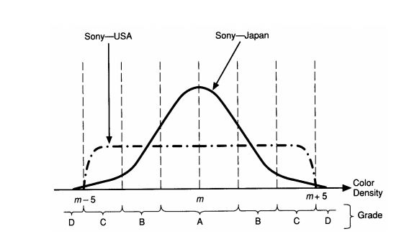
TAGUCHI LOSS
FUNCTION

Slide 28
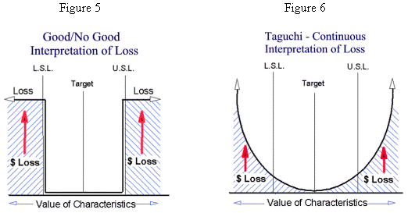
TAGUCHI LOSS FUNCTION (QUALITY LOSS FUNCTION)

Slide 29
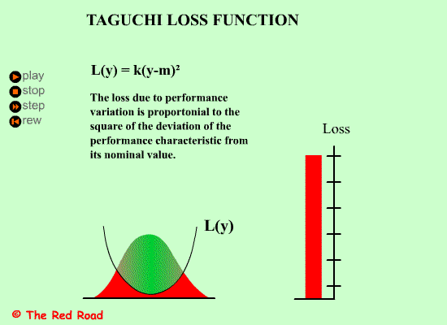

Slide 30
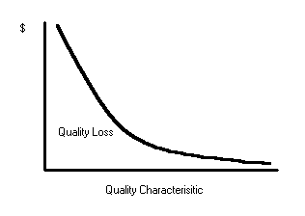
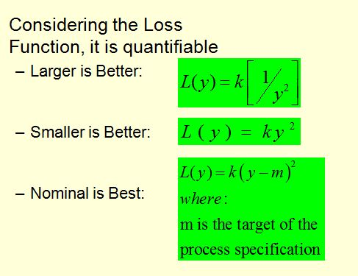
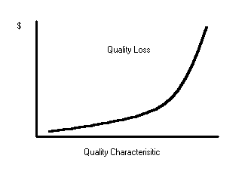
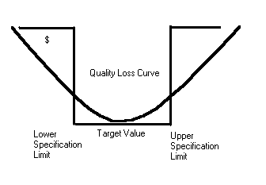
TAGUCHI LOSS
FUNCTION

Slide 31
PROBLEM 1
Company X receives an average of 10 complaints per month. In November they received 15 complaints .Management sets an acceptable level at 2 .It costs the company $150 directly per complaint to correct the problems. Find out the loss associated with the fall of quality.

Slide 32
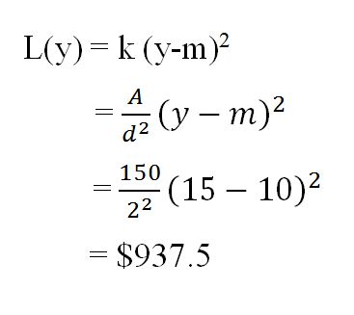
PROBLEM 1 SOLUTION
Here, Nominal (average) value = 10
y= 15, A = $150, d= 2

Slide 33
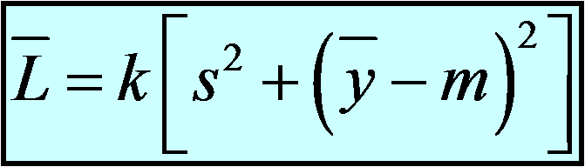
QUALITY LOSS FOR A PROCESS
We can define a processes average loss as:
s is process (product) Standard Deviation
y_{bar} is process (product) mean

Slide 34
PROBLEM 2
In a metal showpiece manufacturing plant, cost of rework is $2. Process specification is: 8.5+.05 units. It was found that the production process mean was = 8.492 and standard deviation was = 0.016 . Find out the loss due to quality deviation of the manufacturing process.

Slide 35
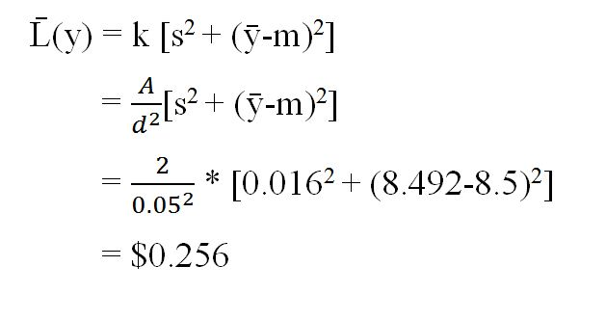
PROBLEM 2 SOLUTION

Slide 36

INTRODUCTION TO ISO9000
ISO stands for International Organization for Standardization
In order to create trust among the customers, in the area of quality, several rule based compliance systems are in place. ISO9000 Quality Management System (QMS) is one of them.
ISO9000 is a set of guidelines as to how the management of an organization, affecting quality of product, or service, should formulate rules and act upon those. It is essentially a management standard, not the product or service standard.

Slide 37
